Slide 1
Unit 203: Electrical installations technology
Alarm and emergency systems

Slide 2
Alarm and emergency systems
Basic alarm circuit configurations:
open circuit
closed circuit.

Slide 3

Alarm and emergency systems
Open circuit

Slide 4

Alarm and emergency systems
Closed circuit

Slide 5
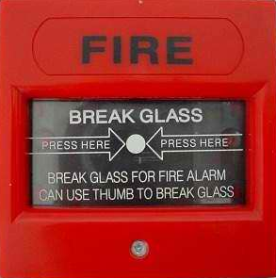
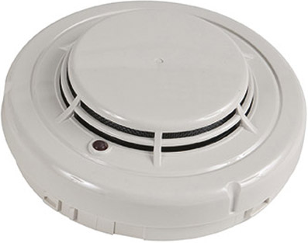
Alarm and emergency systems
Fire alarm – protects:
life
property.

Slide 6

Alarm and emergency systems
Fire alarm – automatic detectors:
smoke detectors
heat detectors
flame detectors.

Slide 7
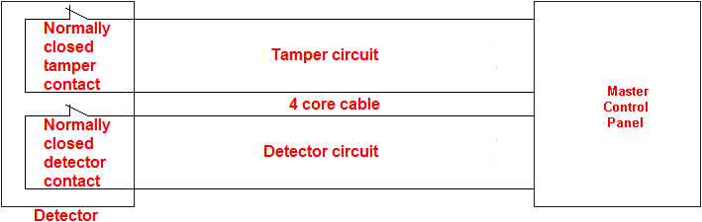
Alarm and emergency systems
Intruder alarm detectors:
break glass detectors
door and window contacts
passive infrared movement detectors
ultrasonic movement detectors
microwave movement detector
beam break detectors.

Slide 8
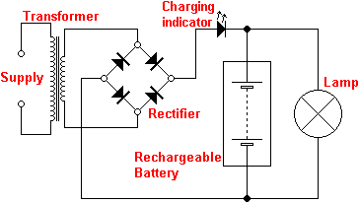
Alarm and emergency systems
Emergency lighting
Maintained

Slide 9
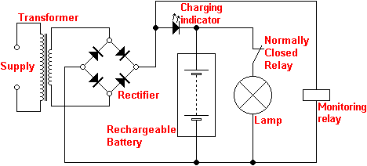
Alarm and emergency systems
Emergency lighting
Non-maintained

Slide 10
Unit 203: Electrical installations technology
The End

